Slide 1
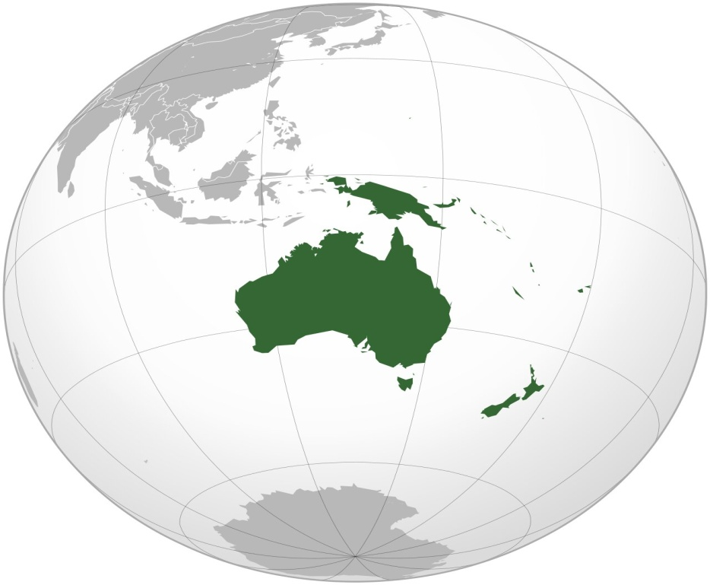
Fashion Brand’s Sales Insight

Slide 2
Overview of the brand & sales performance

Slide 3
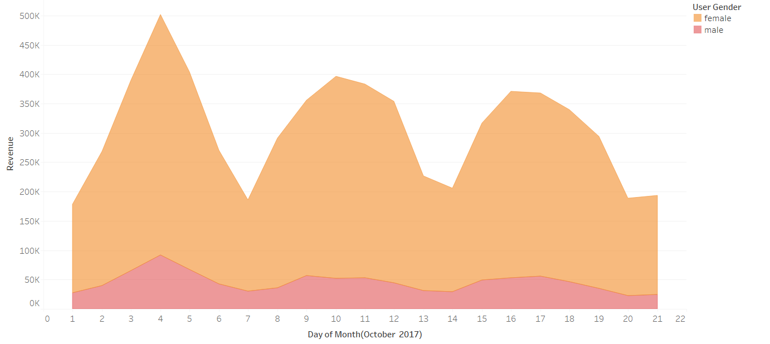
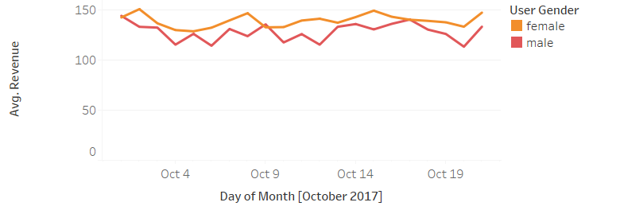
Average sales vs Total Sales Comparison on DAY By Day BASIS

Slide 4
Trends
General trend in sales remain same for males and females.
Average revenue on daily basis is slightly higher for female than men but there are more female than men on any given day.
.Variation in average revenue on day-today basis is small for both.
Customers of the brand tend to buy more during the early weekdays(Monday ,Tuesday, Wednesday).
More customers purchase during the start of the month and as the month progresses there tend to purchase less in comparison.

Slide 5
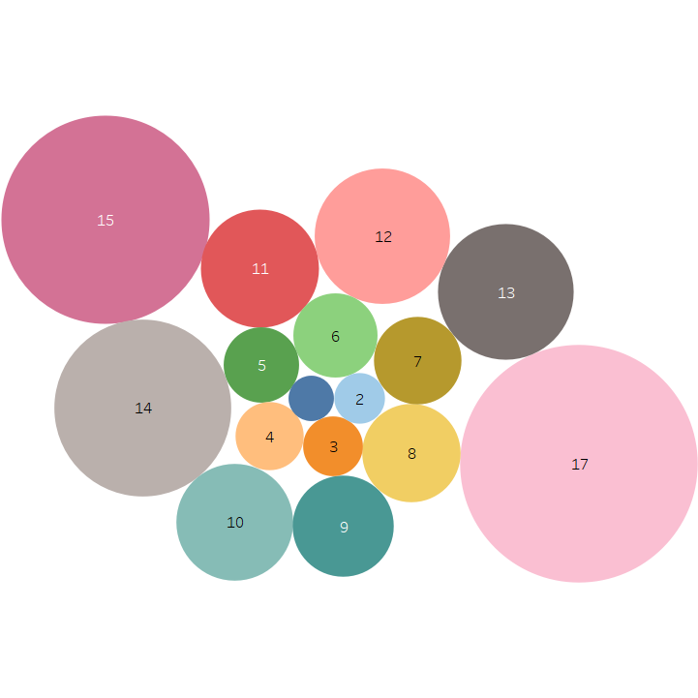
Basket
Here quantity represent the number of unique products and balloon size represent the average revenue from the unique products purchase.
This bubble chart could be interpreted as more the number of unique quantities purchased, more will be the revenue as a result from that purchase.

Slide 6
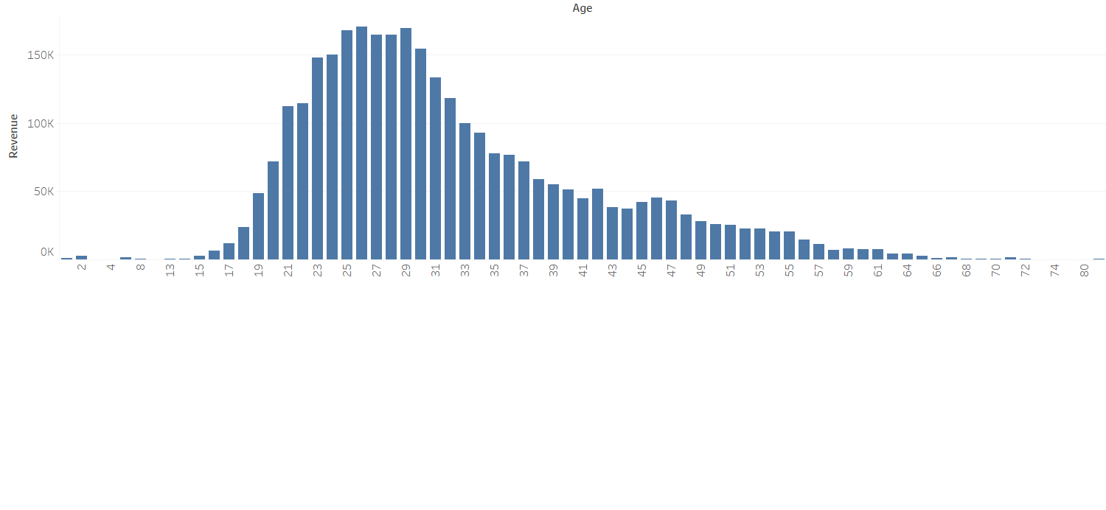
Age trend: Large Number of customers of Brand are millennial(21-37 years Old)

Slide 7
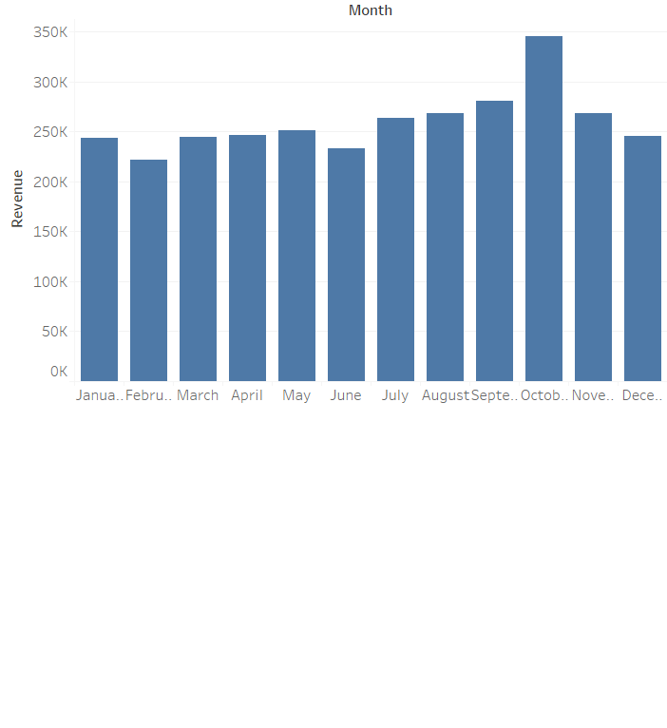
Birth Month Trend
People born in October seems to buy more in the first half of October 2017 in compare to those born in rest of months.
This trend suggest that people tend to buy from the fashion retailer in their birth month. This trend need to be investigated more for further analysis.

Slide 8
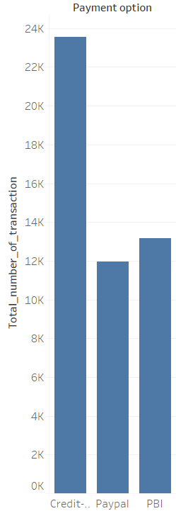
Payment Type Trend
Large number of order payment are through credit-card . Incentives like discount on credit card purchase could be given capitalize on this trend.

Slide 9
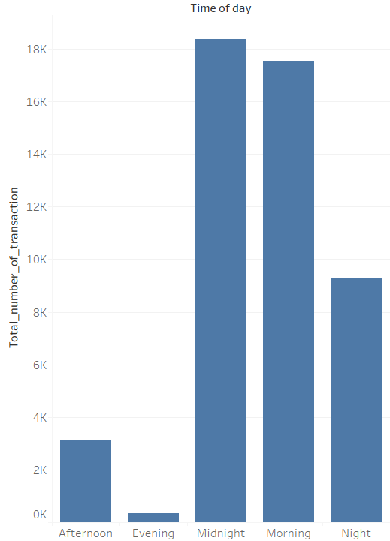
Time of Day: Trend
Large number of purchase have happened during mid-night and early morning .
Ads should be targeted towards audience during midnight and early morning hours.

Slide 10
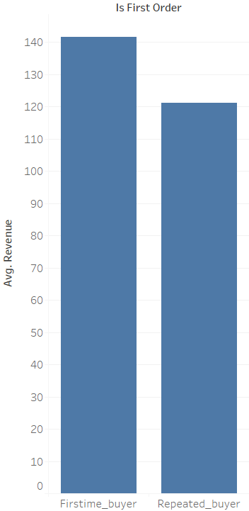
First order or Not
Revenue from first time buyers tend to more in comparison to repeated buyers on an average.
Large discount offer could be given to first time buyers to attract more first time purchasers, who tend to spend more on an average.

Slide 11
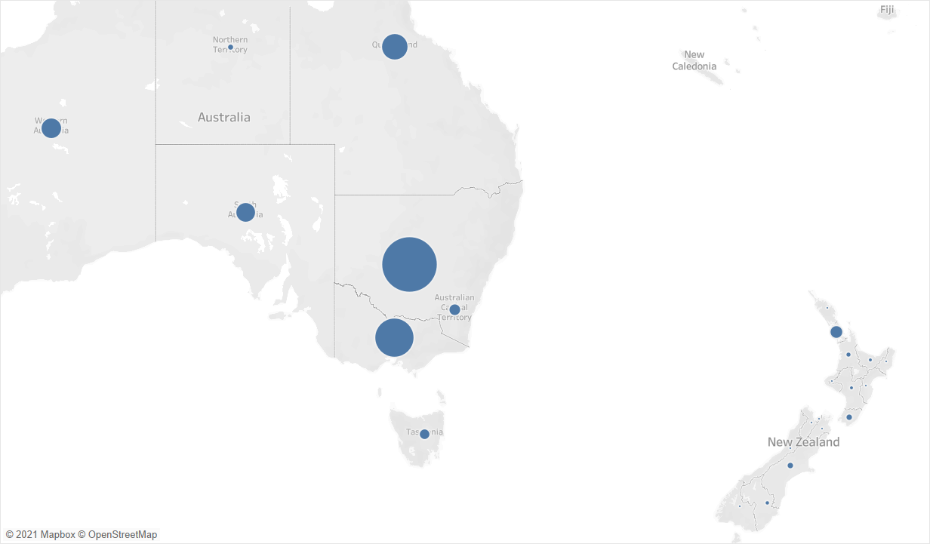
Target Regions
Based on the revenue data , our major target regions for marketing spending should be :-
Australia: Victoria, New south wales,Queensland
New-Zealand: Auckland

Slide 12
Single And Multi-Purchasing :Analysis

Slide 13
Single Vs Multi purchase Transition frequency
Notes:
80% of transactions are single user transaction and rest 20% are transactions are transaction in which single user is doing multiple transaction.

Slide 14
Single Vs Multi purchase User
Notes:
90% users did only one transaction in the first half of October. Rest 10% did multiple transaction.

Slide 15
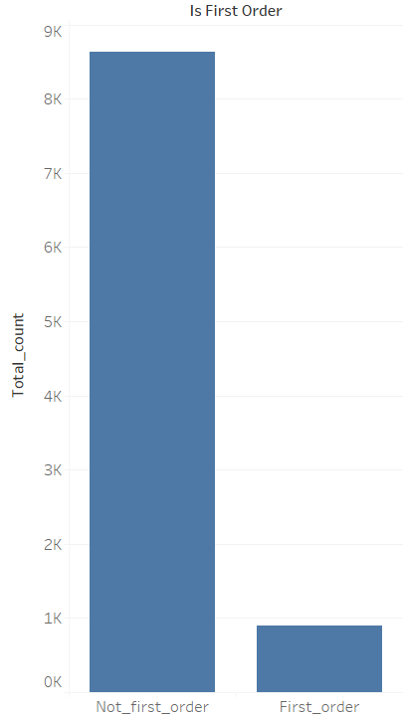
Attribute To Identify Multiple Purchase
Multiple purchasers generally tend to be regular buyer and are mostly not the individuals who ordered after their first order within the month.
For multiple purchases, ads should target individuals who have been purchasing from the retailer for some time and not the folks who brought just first time from the outlet just a few days ago.

Slide 16
Product Affinity
Product affinity has been calculated by determining the frequency of all possible subset of ordered baskets(having high frequency).
A list on next slide gives a part of product combination list . These product are likely to be sold together and could be offered to user in a bunch in order to generate greater revenue.
For a comprehensive list please find the an excel file attached containing all the possible combination of product which could most likely be sold together.

Slide 17
Product affinity list
Modern Cotton Bralette,Modern Cotton Bikini Briefs
Modern Cotton Bralette,Modern Cotton Thong
Bikini,Customised Stretch Bralette
Maui Rib Bikini Briefs,Maui Rib Top
Belilze Balconette Bikini Top,Dominica High Waisted Briefs
Crew Neck T-Shirt,Crew-Neck T-Shirt
T-Shirt,Crew-Neck T-Shirt

Slide 18
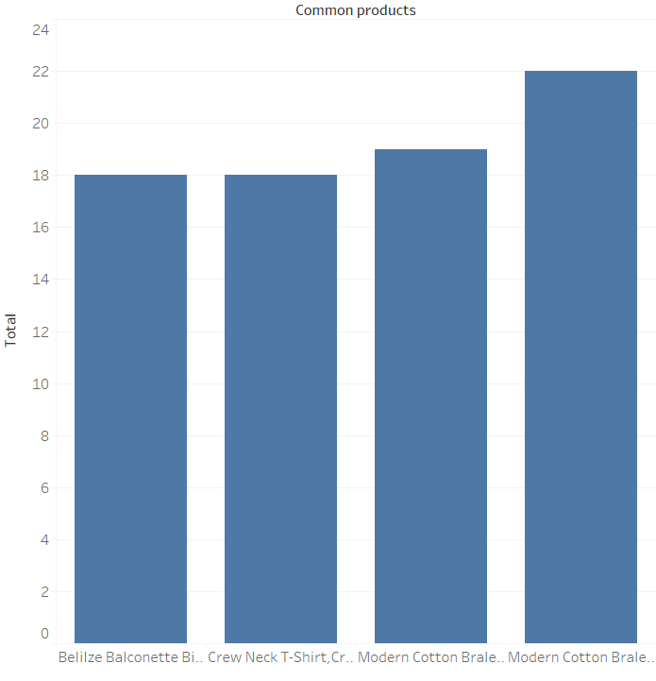
Frequency Distribution of Associated Products(Top 4)

Slide 19
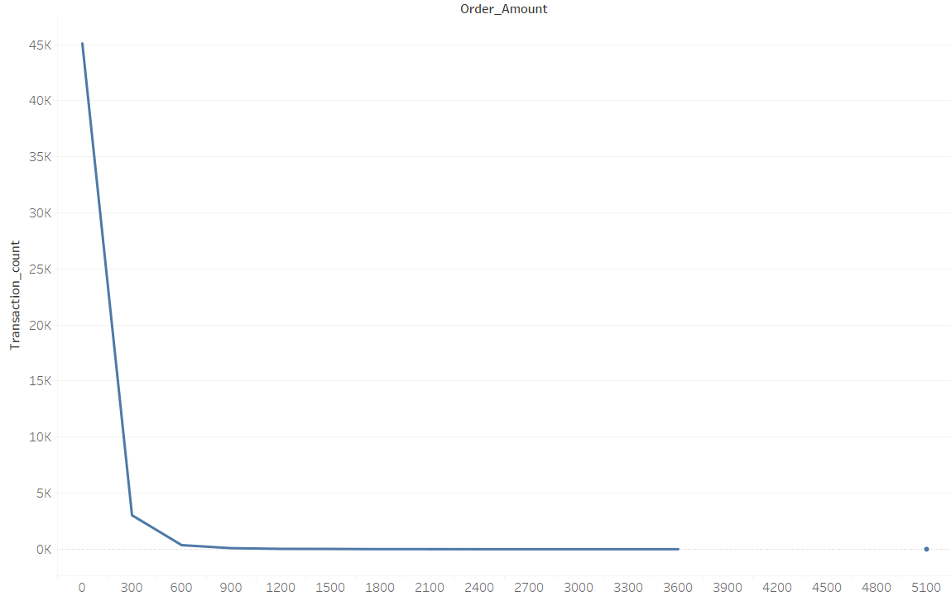
Customer Segmentation Based on Order Amount

Slide 20
Statistical Segmentation of Brand Audience Based on Revenue Per Transaction
Based on revenue per order , fashion retailer’ audience can be segmented as :-
Less than $300- High frequency segment
Greater than $300-Low frequency segment

Slide 21
Frequency distribution of the Segments

Slide 22
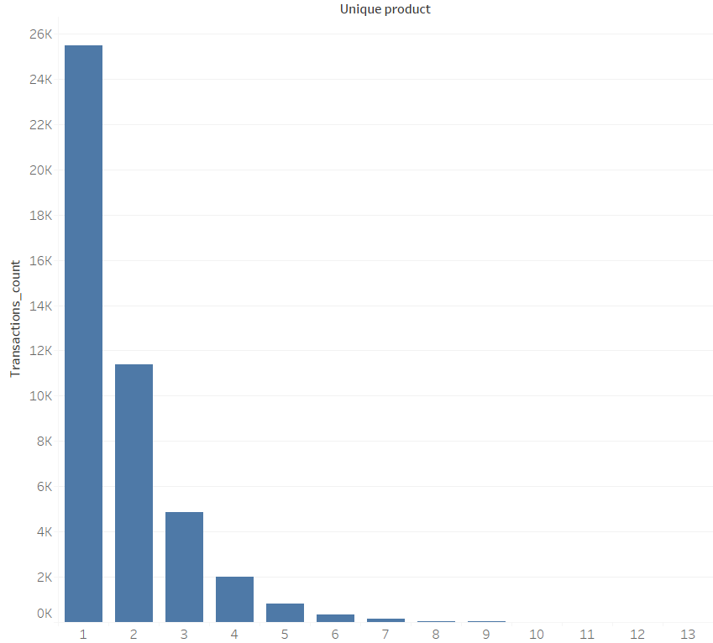
Less than 300: Unique Items Distribution
In less than $ 300 revenue per order segment, large number of customers ordered mostly 1 or two unique products.
For targeting this category of customers large variety of product choices(in accordance with their personal attribute) along with the associated products should be offered to increase sales.

Slide 23
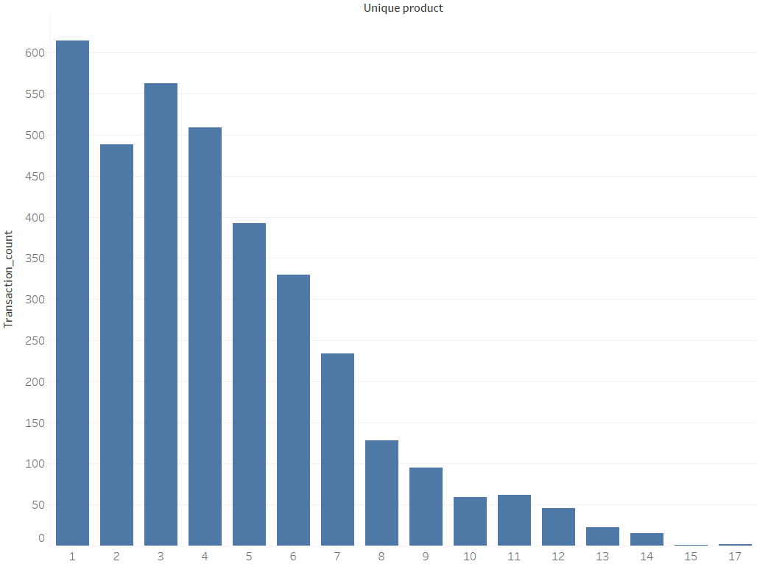
Greater than 300: Unique Items Distribution
In greater than $ 300 revenue per order segment, large number of customers have purchased variety of unique products.
For targeting this category of customers big discount should be offered on purchase of large number of unique products.

Slide 24
Customer Targeting Strategy
Marketing campaign should be designed to target more female customers.
Ad frequency should be increased as the month starts and on the early weekdays (Monday, Tuesday).
Ad frequency should be significantly increased during midnight(12:00 AM-6:00AM) and early morning hours(6:00 AM-12:00 PM)
More marketing spending and efforts should be dedicated towards south-eastern Australian provinces such as New south Wales, Victoria & Auckland region of New-Zealand.
Ad campaign should be designed with millennial(21-37 years old ) in focus as they contribute significant revenue to the firm.
Customers should be incentivize to buy large number of unique products through discount .
Some discount can be offered for credit-card users as credit card is the dominant mode of payment.
Special birthday discount can be offered on purchase just before the customers birthday.

Slide 25
Thank you!
By: Himanshu Kumar Singh

